Slide 1
Project ​ Total Revenue Prediction of Electronic Sales
Submitted by:​
Jobina Joy - C0924759​
Anand Chathananickal Sajeevan - C0928396​
Abhishek Mungath - C0928517​
Jeffin Kochurani Ravi - C0925106

Slide 2
Introduction
Objective:
Key Features:
Provide a user-friendly interface to predict total revenue using various regression models.​
Leverage historical product data and machine learning models to forecast financial outcomes.
User Input Parameters​
Model Selection​
Revenue Prediction​
​

Slide 3


Data Preparation
Steps Taken
New Features Created
Merging multiple datasets​
Handling missing values​
Encoding categorical variables​
Scaling numerical features
Order Processing Time​
Order Weekday, Month, Year​
Total Revenue (Target Variable)

Slide 4
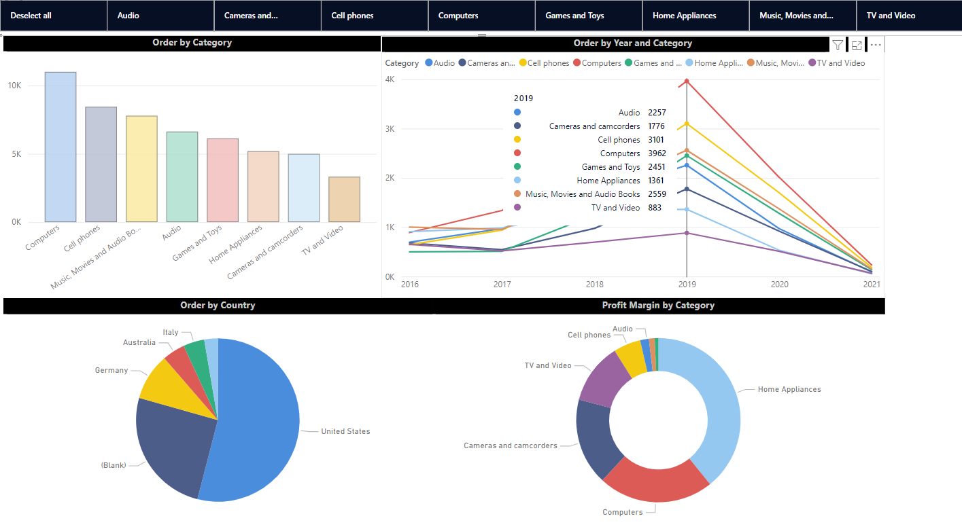
Data Visualization

Slide 5
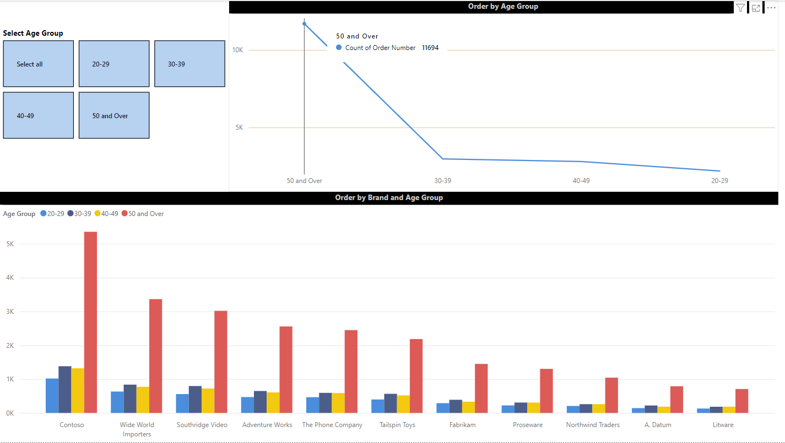
Data Visualization

Slide 6
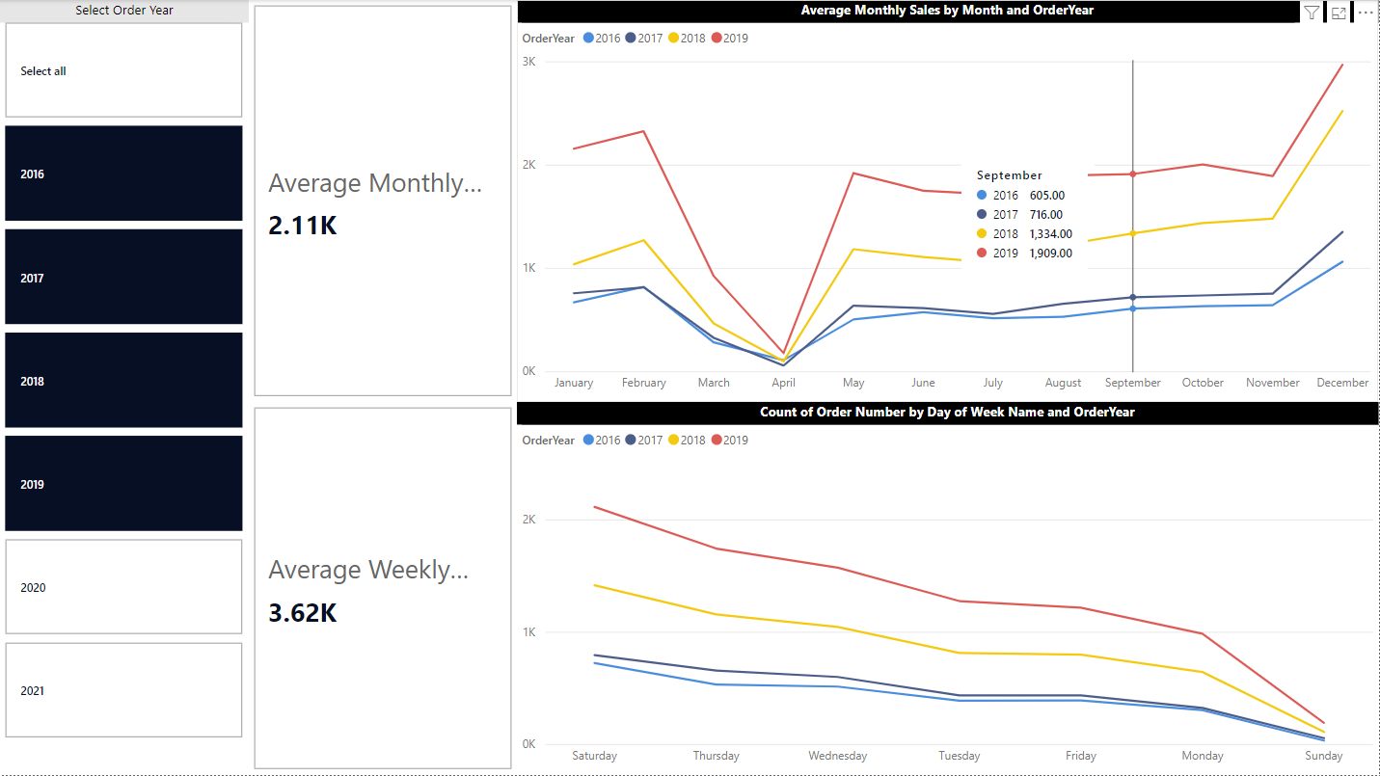
Data Visualization

Slide 7


Model Selection
Models Used
Pipeline Setup
Linear Regression​
Elastic Net​
Lasso Regression​
Ridge Regression
Label Encoding​
Scaling​
Model Training

Slide 8


Model Evaluation
Metrics
Result
Root Mean Squared Error (RMSE)​
R-Squared (R²)
Linear Regression: RMSE: 829.83, R²: 0.72
Elastic Net: RMSE: 829.83, R²: 0.72
Lasso Regression: RMSE: 829.80, R²: 0.72
Ridge Regression: RMSE: 829.83, R²: 0.72

Slide 9
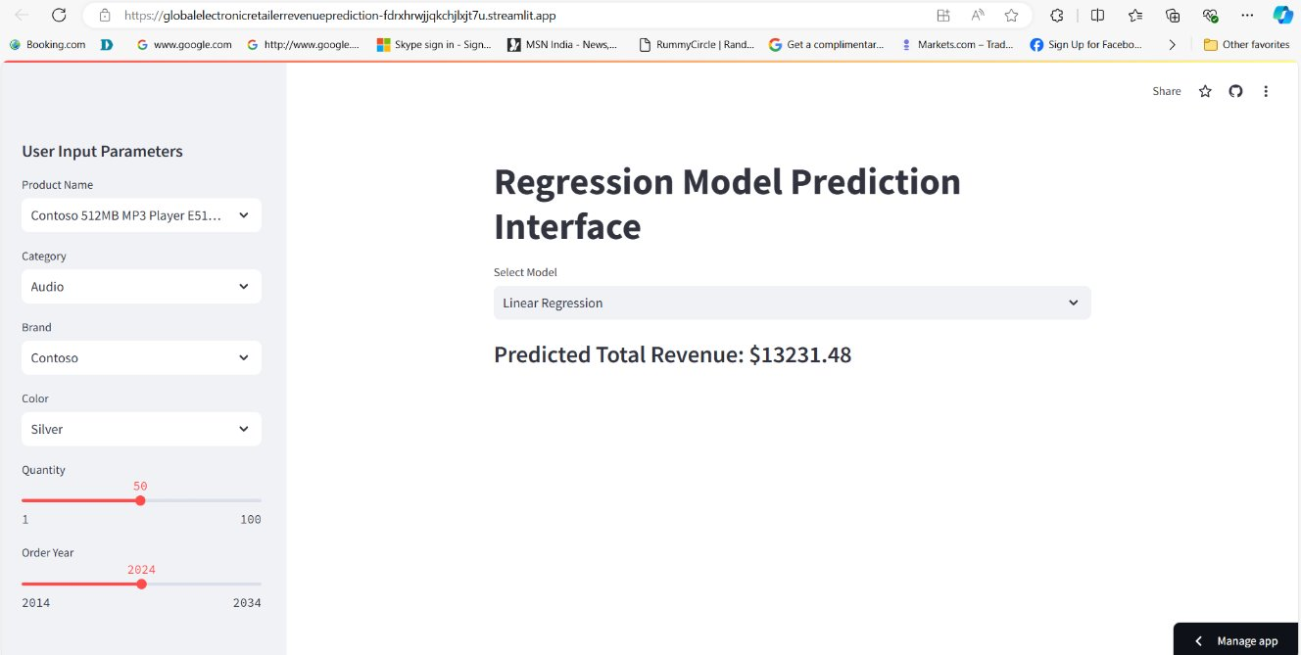


Front End Development
Streamlit Sidebar Inputs: User selects Product Name, Category, Brand, Color, Quantity, and Order Year.​
Real-time Filtering: Product details are filtered based on user selection.​
Model Selection: User can choose from four different regression mod
Demo link to the website
Click here

Slide 10



Model Deployment
Saved models and app.py that access the saved models are Checked in on git.
Connected git hub repo streamlit app.
Deployed the model in streamlit app

Slide 11

Thanks!
Do you have any questions?

